Slide 1
Latest Corona report

Slide 2
Introduction
THIS COMPLETE PROJECT IS ABOUT THE PIZZA SALES AND USING THIS DATA, CAME UP WITH THE VALUEABLE INSIGHTS IN A DASHBOARD.
THIS COMPLETE DATA SET HAS 15 COLUMNS AND TOTAL 188 ROWS.
AND THE FIELDS OR TERMS WHICH THIS DATASET HAS ARE AS FOLLOWS:
Region , Confirmed , Deaths , Recovered , Active , New cases , New Deaths , WHO Region

Slide 3
PROBLEM statements
Total Confirmed Cases
Total New Cases
Total Deaths
Total Recovered
Region Wise Top 5 Confirmed Cases
Region Wise Bottom 5 Confirmed Cases
WHO Region By Confirmed Cases, Deaths Cases, Recovered Cases.

Slide 4
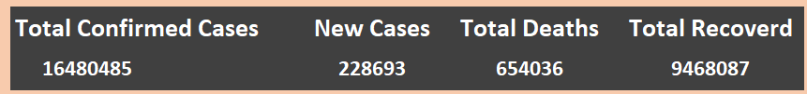
Total Confirmed Cases, New cases, Total deaths, Total Recovered

Slide 5
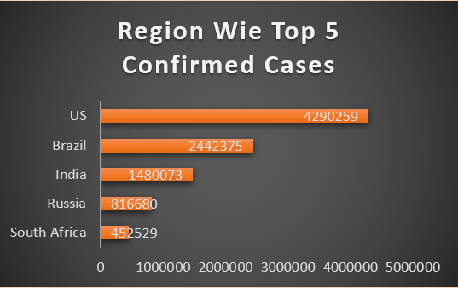
Region Wie Top 5 Confirmed Cases

Slide 6
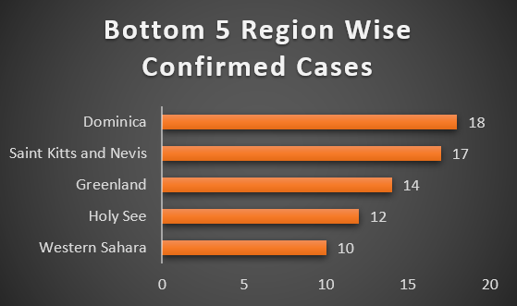
Bottom 5 Region Wise Confirmed Cases

Slide 7
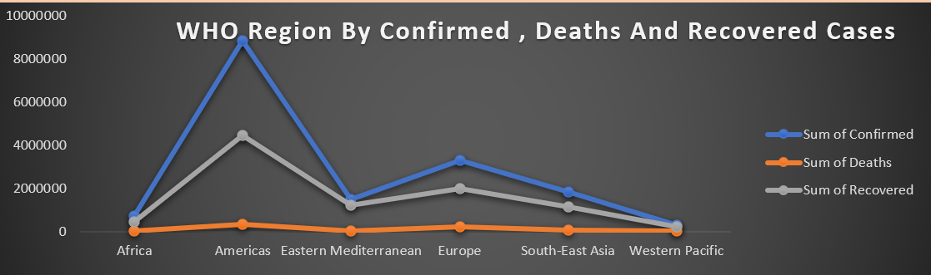
WHO Region By Confirmed , Deaths And Recovered Cases

Slide 8
INSIGHTS :-
USA Is High Which is Total Cases 4290250
Western Sahara Is Lowest Which Is Total Cases 10

Slide 9
THANK YOU

